Slide 1

Eco-evolutionary dynamics & life history
By Evelyn K, Nicole J, Ladio J, Saran A

Slide 2
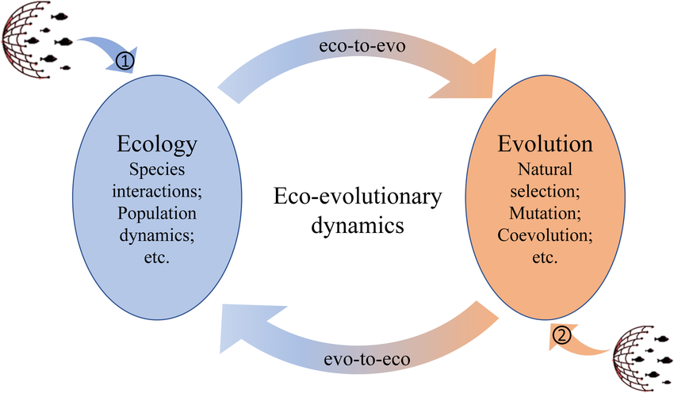
What are eco-evolutionary dynamics ?
The reciprocal effects that ecology & evolution have on each other.
https://www.researchgate.net
Notes:
Eco-evolutionary dynamics are the study of how ecological processes & evolutionary processes, interact & influence each other in a reciprocal feedback loop.
The idea that evolutionary processes can occur quickly alongside with ecological processes led scientists to begin studying the influence evolution has on ecology along with the affects ecology has on evolution.
Example: Beavers and ponds.
Beavers posses behavioral patterns and physical traits that enable the construction of ponds. Once constructed, these ponds alter the local ecological conditions which further hone the evolution of those traits and behaviors, which lead to further change in the environment. Thus beavers and ponds play off one another in a eco-evolutionary feedback loop, where the species modifies its surroundings and those environmental changes in turn further influence the species.
*Def ecological processes (biological, physical, & chemical interactions that sustain the ecosystems, linking living organisms with their non-living environment).
*Def evolutionary processes (the mechanisms that lead to changes in the heritable traits of populations over generations).

Slide 3
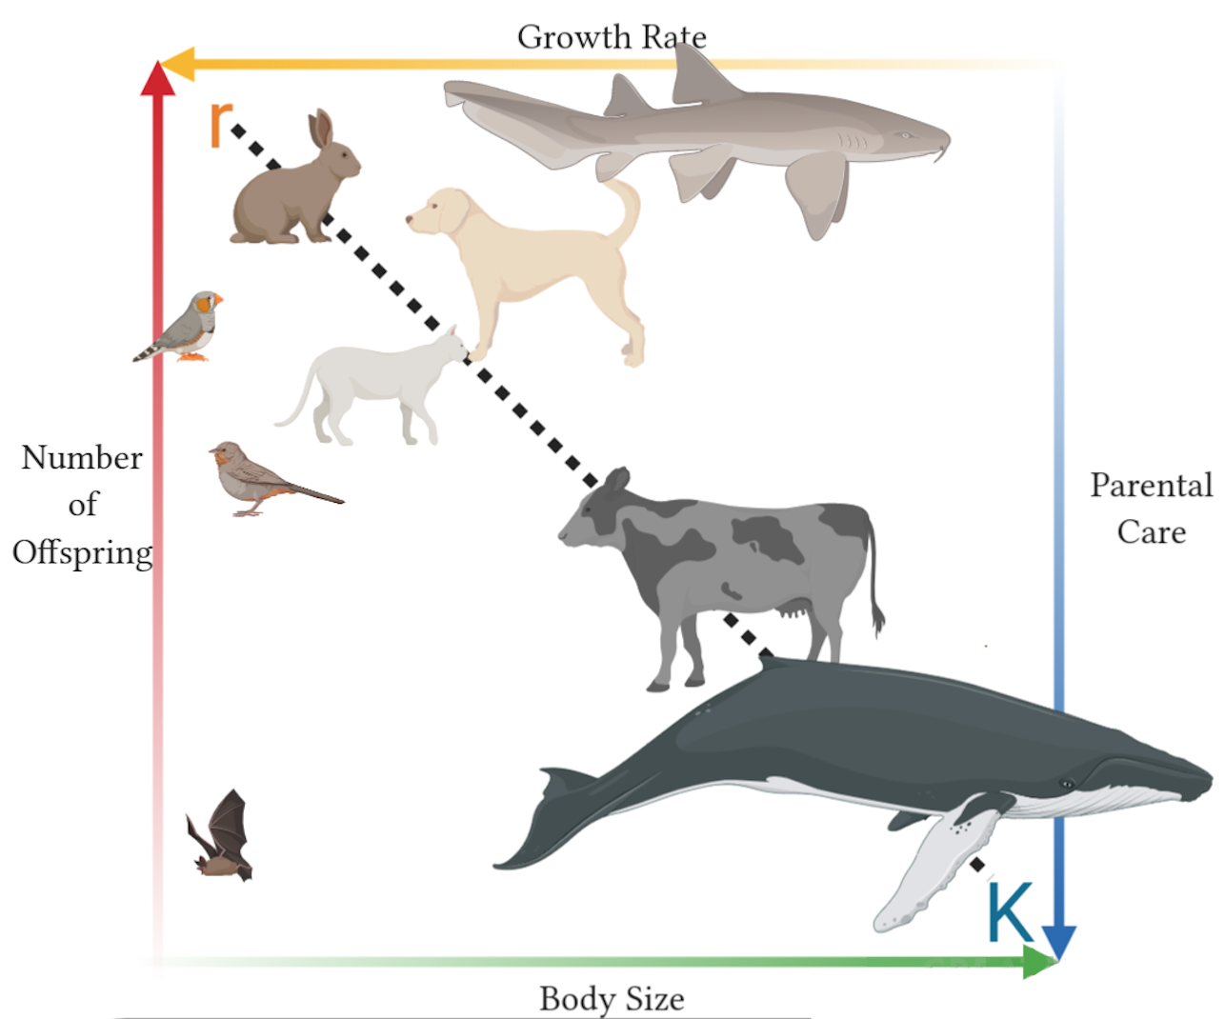
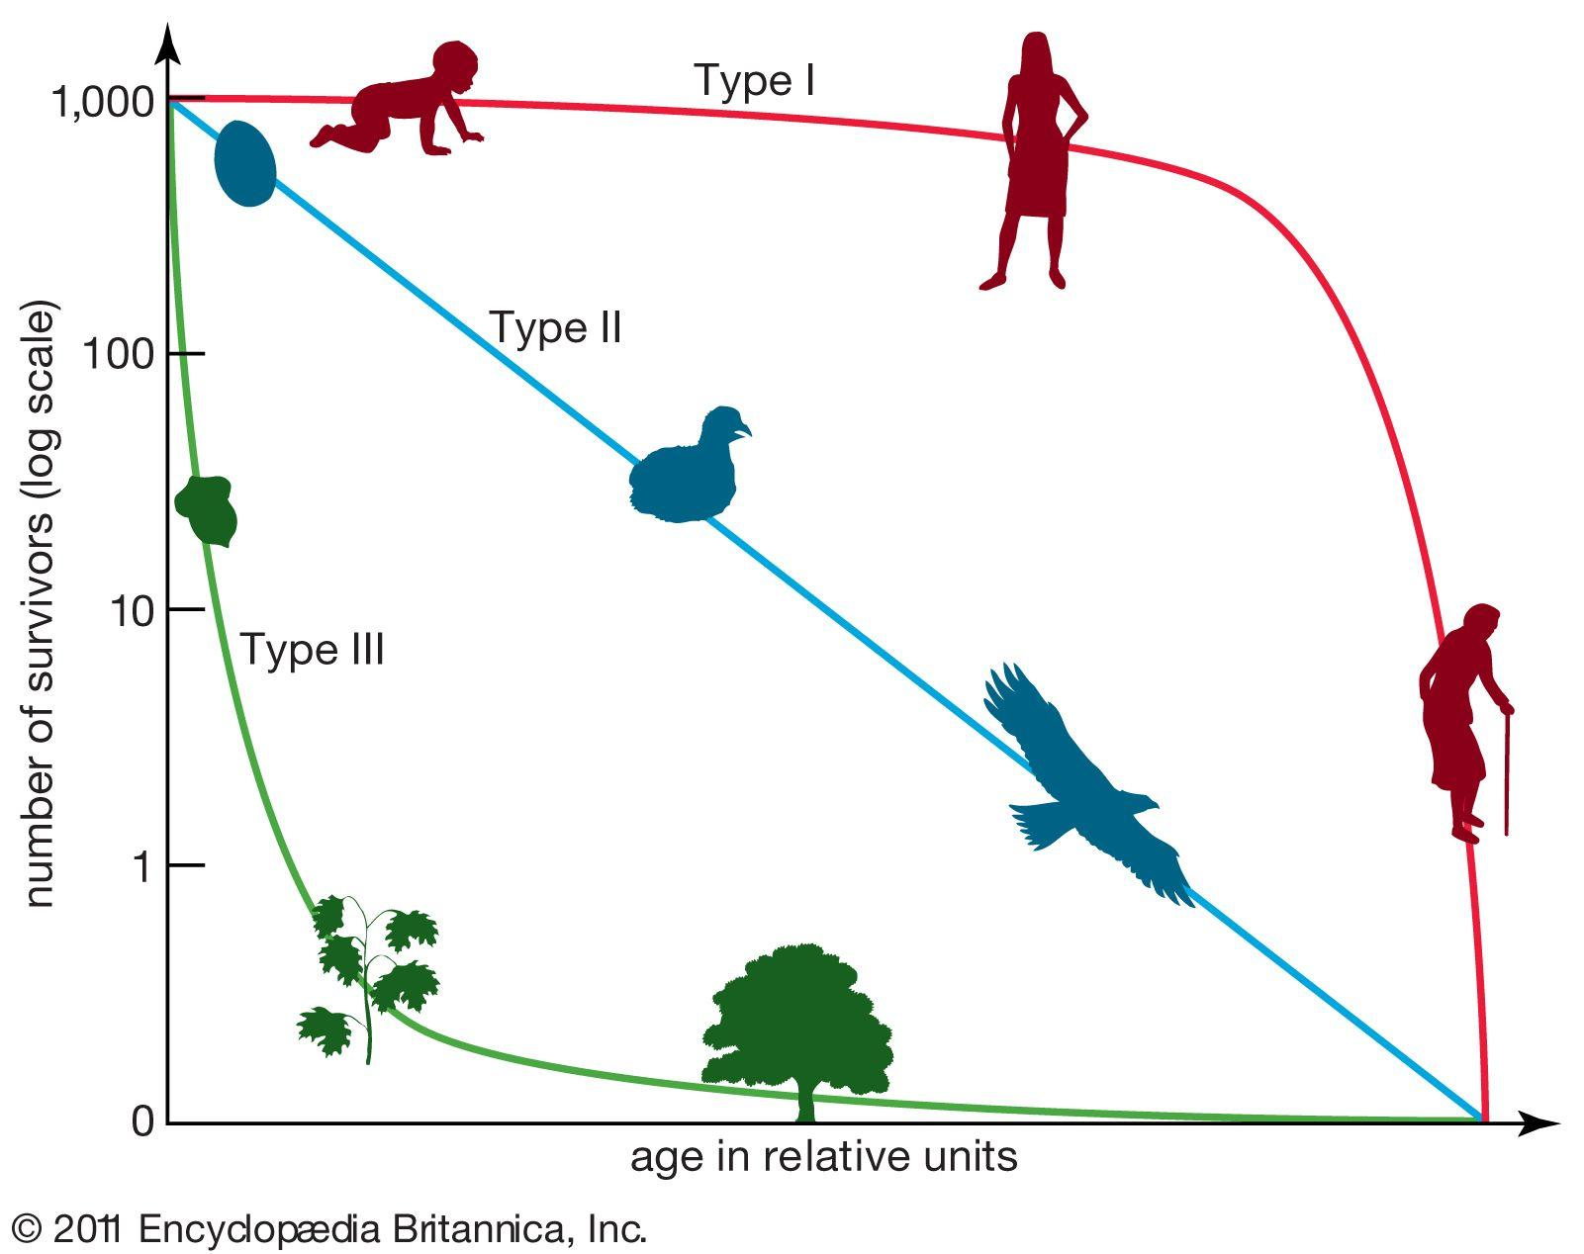
https://www.britannica.com
Notes:
Why do we need a survivorship curve ?
To answer questions like how long do individuals of diff species live ? How many individuals reach maturity ? How many individuals die young ? The survivorship curve is a graphical representation that gives answers to these questions.
What is a survivorship curve ?
It’s a graph showing the number or proportion of individuals surviving to each age for a given species or group.
There are diff types of survivorship curves.
Convex curve : High survivorship throughout life, majority reach maturity, typically k-selected species, late loss (ex: humans, elephants).
Diagonal curve : Constant loss, independent of age (ex: birds, rodents).
Concave curve : Early loss, low mortality after maturity, typical of r-selected species (ex: oysters, small fish).
*k-selection (density dependant selection) & r-selection (density independent selection).

Slide 4
What is life history theory?
Def. - A framework for studying how organisms allocate time and energy to growth, reproduction, and survival and how these trade offs define their life cycles and evolution.
Notes:
Life history theory is understanding how organisms allocate their limited time and resources across growth, reproduction, and survival. It delves into the trade-offs they may encounter like the need to invest more energy into reproduction that will reduce the resources for growth and survival, which can affect their chances of survival. This explains why different species evolved a different life cycle and strategies to maximise time and energy in their specific environment.
Life history are the traits that affect an organism's schedule of reproduction and survival.
Different types of life history strategies, like semelparity (1 time reproduction, ex: salmon) and iteroparity (multiple reproductions; most vertebrates).
Understanding life history helps predict favored traits in various environments and evolutionary impacts on lifespan and reproduction.
2 ways we characterize life history, r and r selected species.

Slide 5
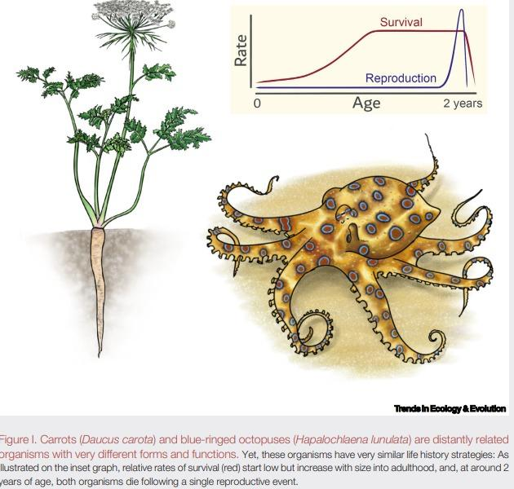
Scott Lain, (2024) Trends in Ecology & Evolution
Notes:
The picture above shows that very different species can share the same life-history strategy.
For example, carrots and blue-ringed octopuses both start small, grow fast, most die young, and the survivors reproduce once at around two years old and then die. In contrast, humans and blue whales grow slowly, mature late, live a long time, and have one offspring every few years.
Life-history strategies don’t depend on how similar species look, distant species can share the same strategy, and close relatives can differ a lot

Slide 6
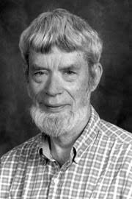
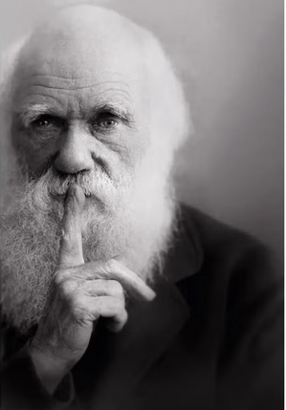
History + Main Figures
Charles Darwin - 1859 - Relation between ecological and evolutionary processes
G. C. Williams - 1966 - Gene-centered view of evolution
https://www.nature.com
https://blog.alandotchin.com
Notes:
Darwin was the first to specify that an organism's ecology acts as the selective pressure that drives evolutionary change.
In order to explain the evolution of aging, G. C. Williams rejected the widely accepted theories of group selection in favor of the idea that a single gene can have both beneficial effects early in life and harmful effects later in life. He proposed that organisms must balance different genetic traits that determine their fitness, such as current versus future reproduction, which can then end up constraining their evolutionary potential.

Slide 7
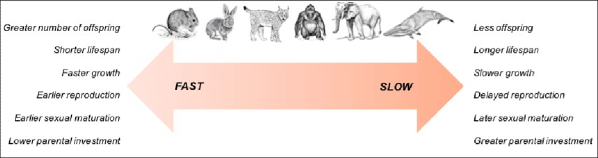
https://www.researchgate.net
Notes:
Next up the Fast slow life history continuum
It is a spectrum of life history strategies and it illustrates the strategies of each species when it comes to reproduction, survival
Fast = Reproduce early, many offsprings, short lifespans and small in size
Example: rabbit, mouse
Slow - few offsprings, grow slowly, live longer, bigger, reproduce later
Examples: whales, elephants
Humans fall into the slow category as they have long lifespans, few offsprings etc.
Concept of fast or slow life history continuum is oversimplified and in real life are much more complex. As there are bigger variations within species rather then between species.
Example: Salmon -different species of salmon may have similar average size but individual salmons in one species may be much bigger, live longer than the average or even go further upstream to spawn than is usual for the specific species.

Slide 8
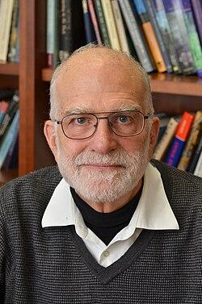
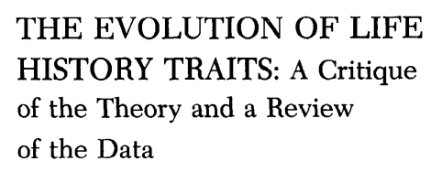
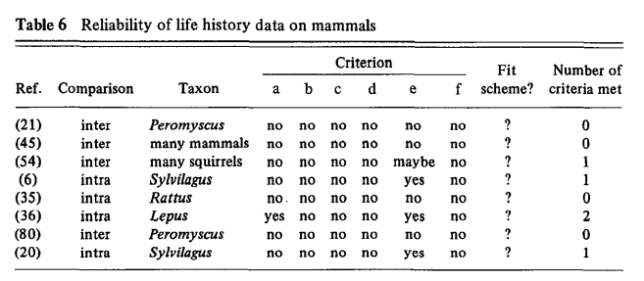
Stearns 1977 Paper
Notes:
Stephen C, Stearns
Helped established Life history theory as a framework to help us understand how organisms divide energy between surviving and reproducing and everything comes down to trade offs
What is a trade off? When an organism cant increase one trait like their lifespan without decreasing another like the frequency of reproduction because its energy and resources are limited
He argues that early-life history models are unrealistic as they assume environments are stable and there are not changes in competition over resources and also dont take randomness into consideration and assume the environment is predictable which it is not.
Concept of trade offs is oversimplified and in real life are much more complex as trade offs may differ based on age, environment and species.
Most species lacked a complete life history datasets so comparative studies could be trusted as they relied on averages in species that were not showing the whole picture of individual variation
Incomplete life records, criteria not met for the vast majority
Species lack full records on growth, reproduction etc.
So in the end comparative conclusions are less trustworthy because they rely on datasets that dont meet scientific standars
And so Stearns was not expanding on the old theory but rather exposing it and showing us what's missing like the high quality data, measured trade offs etc. and it is because of him that the field expanded into better data and better models making Stearns and his 1977 paper the groundwork for modern life history research
Lepus=hare/zajic has 2 as the only one

Slide 9

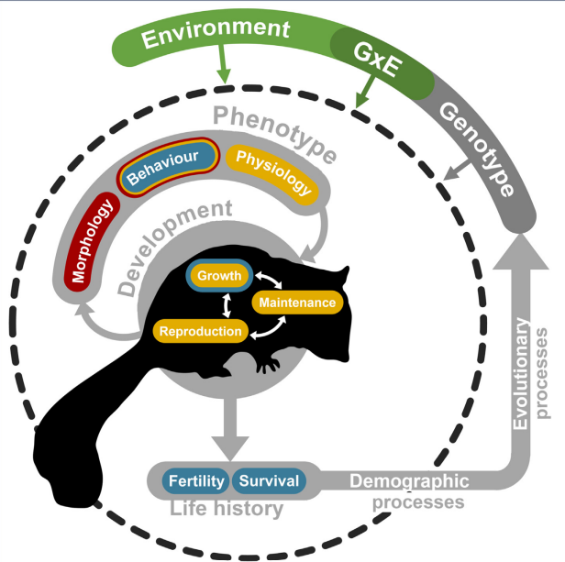
Stott et. al 2024 Paper
Notes:
This paper is a meta analysis on the current research based state of life history theory. It points out how the field currently struggles with unclear links between theory and real-world patterns. The authors lay out recommendations to help the field evolve into a more hypothesis-driven science.
Standardize measurements of life history traits as a “currency” expressed as rates per unit time.
Create accurate family trees reflecting realistic forms of evolution
Adopt statistical methods that are phylogenetically aware to include shared ancestries.
Account for the macroevolution of life histories, such as how organisms allocate resources to growth, how multiple life history strategies can jointly be successful and how life histories change between different life stages.
Fill gaps in data for understudied organisms as current data favors vertebrates and completely neglects huge groups like microbes and fungi that tend to have unusual life cycles or modular structures.
Acknowledge that cross-taxon comparisons are possible, and suggest that life history variation is more universal than expected.

Slide 10
Comparisons

Slide 11
 | 1977 Stearns | 2024 Stott et al.
Data availability | Species/population specific datasets, vertebrate-focused, poorly measured data | Vast datasets, standardized databases
Trait measurement | Incomparable, simple models and statistics, analysis through intuition | Standardized definitions, structured demographic matrices
Comparative scope | Few species; limited cross-taxon comparisons | Thousands of species; broad taxonomic integration
Analytical methods | Basic statistics; no phylogenetics | PCMs, multivariate models, Bayesian analyses
View of life-history variation | Multiple traits, but conceptual uncertainty; trade-off emphasis | Multidimensional; variation in reproductive strategy, developmental timing, lifespan and pace of life
Explanatory power | Limited by weak empirical support, inconsistencies between data and theory | High explanatory power; complex models possible
Major critique | Empirical tests too weak to confirm theory | Comparative studies are descriptive, argues that we need to return to stronger theory integration with modern tools
Notes:
What we really want to focus on in this table is how the advancement in data processing and ecological database strength affected what conclusions were able to be made regarding life history theory. Ecologists are now able to formally detect multiple axes of life-history variation with modern technology. Patterns that were invisible in 1977 due to poor data availability and trait measurement show up clearly today.

Slide 12
Main Takeaways
Life histories follow many dimensions.
Theory has become deeper and more integrative.
Modern work strengthens earlier ideas.
Strategies shaped by multiple influences.
Notes:
So overall, the main takeaway from both papers is that life histories are much more multidimensional than we used to think — they can’t be reduced to just fast versus slow. Over time, the field has shifted from very simple ideas about trade-offs to more complex and integrated frameworks.
Modern life-history theory builds directly on the early critiques, and because of better data and better tools, we now have stronger explanations for why species differ the way they do. And finally, both papers emphasize that life-history evolution isn’t shaped by one factor alone — it’s the combined influence of environment, development, and evolutionary ancestry working together. Life history biology is becoming more standardized, more comparative, and more universal than ever before.
(Scale of taxonomic data increased
Analytical tools are able to capture the biological complexity of organisms
Conceptual evolution transitioned from thinking on a single axis to multidimensions
“Is this theory correct” (1977) → “what does high-dimensional variation look like, and why?” (2024)
Life-history theory has undergone almost 50 years of development between Stearns’ 1977 critique and Stott et al.’s 2024 synthesis. The transformation is profound: the 1977 paper was written at a time when data were sparse, theory was embryonic, and analytical methods were limited; the 2024 paper emerges from an era of massive cross-taxonomic datasets and sophisticated statistical, phylogenetic, and conceptual tools. )

Slide 13


Slide 14

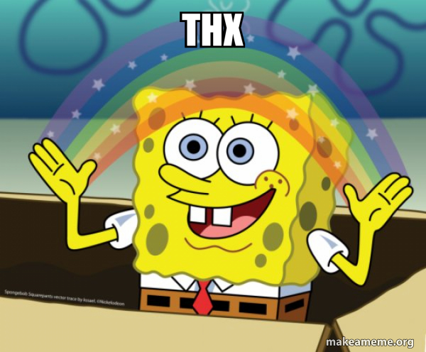

Thank You :D !

Slide 15
Resources
Scott Lain, (2024) Trends in Ecology & Evolution, Nature reviews genetics vol. 39, No. 9
Stephen C Stearns, (1977), The Evolution of Life History Traits: A Critique of the Theory and a Review of the Data, Annual review of Ecology & Systematics
https://www.youtube.com/watch?v=eMYuapm-BgY
https://en.wikipedia.org/wiki/Life_history_theory
https://en.wikipedia.org/wiki/Eco-evolutionary_dynamics
https://www.youtube.com/watch?v=XsnRil3mg4Q
https://www.sciencedirect.com/science/article/pii/S0960982223008576

